Slide 1

Hardware Descriptive Language(HDL)
Lecture # 3

Slide 2
Taste of Verilog
Module name Module ports
module Add_half ( sum, c_out, a, b );
input a, b;
sum, c_out; c_out_bar;
Declaration of port modes
output
wire
Declaration of internal signal
Instantiation of primitive gates
xor (sum, a, b);
nand (c_out_bar, a, b);
a b
not (c_out, c_out_bar);
sum
endmodule
c_out_bar
Verilog keywords
c_out

Slide 3
Modules
The Module Concept
Basic design unit
Modules are:
Declared
Instantiated
Modules declarations cannot be nested
Everything you write in Verilog must be inside a module exception: compiler directives

Slide 4
Verilog Module
Description of internal structure/function
Implementation is hidden to outside world
Communicate with outside through ports
Port list is optional
module Add_half ( sum, c_out, a, b );
input a, b;
output sum, c_out;
wire c_out_bar;
xor (sum, a, b);
nand (c_out_bar, a, b);
not (c_out, c_out_bar);
endmodule
a b
sum
c_out_bar
c_out

Slide 5
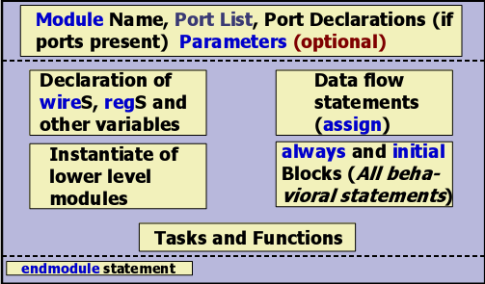
Components of a Verilog Module

Slide 6
Identifiers - must not be keywords!
Formed from {[A-Z], [a-z], [0-9], _, $}, but can’t begin with $ or [0-9]
Case sensitivity
myid ≠ Myid
Ports
Ports are like pins on chip
Type: defined by keywords
input
output
inout (bi-directional)

Slide 7
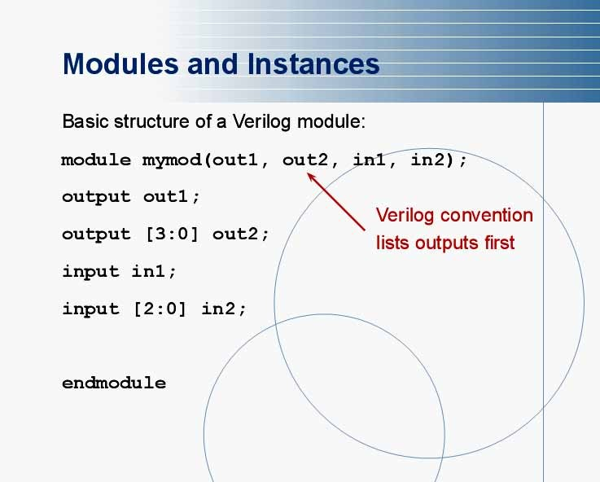

Slide 8
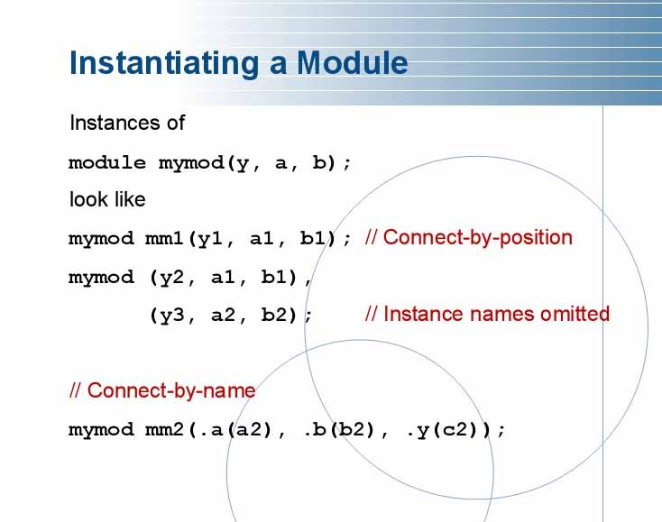

Slide 9
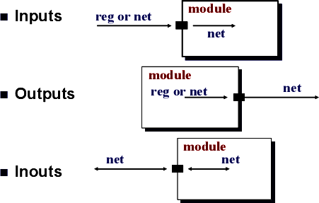
Port Connection Rules

Slide 10
Width matching
It is legal to connect internal and external items of different sizes when making inter-module port connections. However, a warning is typically issued that the widths do not match.
Unconnected ports
Verilog allows ports to remain unconnected. For example, certain output ports might be simply for debugging, and you might not be interested in connecting them to the external signals.
fulladd fa0(SUM, , A, B, C_IN); //Output port c_out is unconnected

Slide 11
Connecting Ports to External Signals
Connecting by ordered list
The signals to be connected must appear in the module instantiation in the same order as the ports in the port list in the module definition.
Connecting ports by name
You can specify the port connections in any order as long as the port name in the module definition correctly matches the external signal.

Slide 12
Ports Connections
By order
By name
Empty port
module child( a, b, c );
…
Endmodule
/////////////////////////////////////////////////
module parent;
wire u, v, w;
child m1( u, v, w );
child m2( .c(w), .a(u), .b(v) ); child m3( u, , w );
endmodule

Slide 13
Comments
// The rest of the line is a comment
/* Multiple line comment */
/* Nesting /* comments */ do NOT work */

Slide 14
Verilog Primitives
Basic element to build a module, such as
nand, and, nor, buf and not gates
Never used stand-alone in design, must be within a module
Pre-defined or user-defined
Identifier (instance name) is optional
Output is at left-most in port list
Default delay = 0

Slide 15
Primitives
Gate Level
and, nand
or, nor
xor, xnor
buf , not
bufif0, bufif1, notif0, notif1 (three-state)
Switch Level

Slide 16
Smart Primitives
module nand3 ( O, A1, A2, A3 );
input output
A1, A2, A3; O;
nand ( O, A1, A2, A3 );
endmodule
Same primitive can be used to describe for any number of inputs
This works for only pre-defined primitives, not UDP

Slide 17
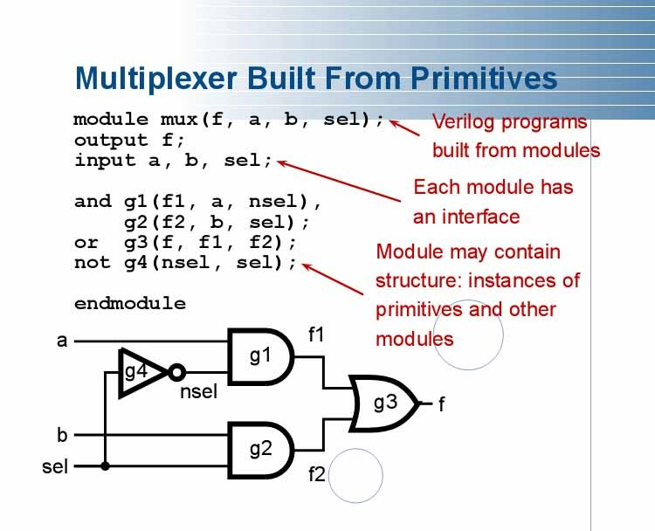

Slide 18
Simulation Component
Stimulus generator
Design Unit Test Bench
Response monitor
Unit Under Test
Unit Under Test

Slide 19
Structured Design Methodology
Design: top-down
Verification: bottom-up

Slide 20
Hierarchical Description
M2
Add_half
sum
c_in
M1
Add_half
a
c_out
b
Nested module instantiation to arbitrary depth
Add_full
M1
Add_half
M2
Add_half
or
xor
nand
not
xor
nand
not

Slide 21
Two main data types
Nets
Net represent connections between hardware elements.
Just as in real circuits, nets have values continuously driven on them by the outputs of devices that they are connected to.
Do not hold their values
Can be thought as hardware wires driven by logic
Cannot be assigned in initial & always block
Equal z when unconnected
Undeclared Nets - Default type
Not explicitly declared default to wire

Slide 22
Reg
Registers represent data storage elements.
Registers retain value until another value is placed onto them.
– Do not confuse the term registers in Verilog with hardware registers built from edge-triggered flip flops in real circuits.
Variables that store values
Do not represent real hardware but real hardware can be implemented with registers

Slide 23
Example 2x1 MUX
module mux_2to1(a,b,sel,f);
output f;
input a,b,sel;
and g1(f1,a,nsel);
and g2(f2,b,sel);
or g3(f,f1,f2);
not g4(nsel,sel);
endmodule

Slide 24
module stimN();
reg A,B,SEL;
wire F;
mux_2to1 M(A,B,SEL,F);
initial
begin
$display("A B SEL F");
A=0;
B=0;
SEL=0;
#1 $display("%b %b %b %b",A,B,SEL,F);
#5 A=0;
B=0;
SEL=1;
$display("%b %b %b %b",A,B,SEL,F);
#10 A=0;
B=1;
SEL=0;
$display("%b %b %b %b",A,B,SEL,F);
#15 A=0;
B=1;
SEL=1;
$display("%b %b %b %b",A,B,SEL,F);
#20 A=1;
B=0;
SEL=0;
$display("%b %b %b %b",A,B,SEL,F);
# 25 A=1;
B=0;
SEL=1;
$display("%b %b %b %b",A,B,SEL,F);
#30 A=1;
B=1;
SEL=0;
#35 $display("%b %b %b %b",A,B,SEL,F);
A=1;
B=1;
SEL=1;
$display("%b %b %b %b",A,B,SEL,F);
end
endmodule

